Slide 1

G2M Case Study
Virtual Internship
21 September 2022
Milan Banjanin

Slide 2
Introduction
XYZ is planning an investment in cab industry - and need assistance!
Objective: analyze cab-related data from 2016 - 2018 and provide support in decision-making process
The following slides will include:
Summary of available data
Data analytics
Final thoughts

Slide 3
Summary of Available Data
12 features/columns
In addition to this, 4 data points have been created from the existing 12
Timeframe: 3 years worth of data (2016-2018)
Number of records available: 359,392

Slide 4
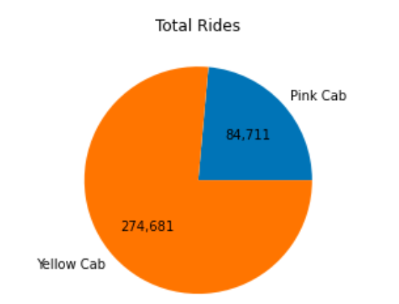
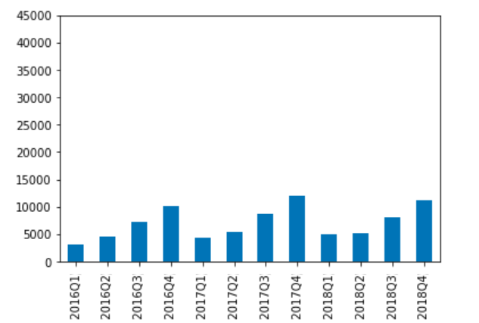
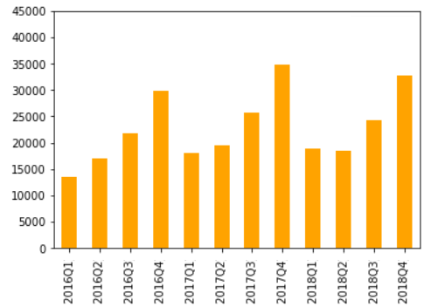
Data Analytics - Number of Rides (total, quarter)
Total number of rides is in favour of Yellow Cab
Number of rides per quarter as well - Yellow Cab dominates
We notice seasonality - as year progresses, we have more and more rides, the highest in Q4 each year

Slide 5
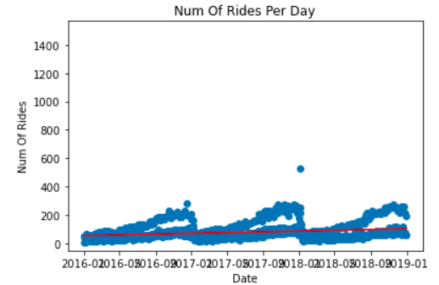

Data Analytics - Number of Rides (daily, trend)
Yellow Cab dominating daily numbers, as expect
Similar seasonality like in quarterly view, - we see New Year outliers
Trendlines for both cab companies are showing positives - upward trend is expected in future years as well

Slide 6
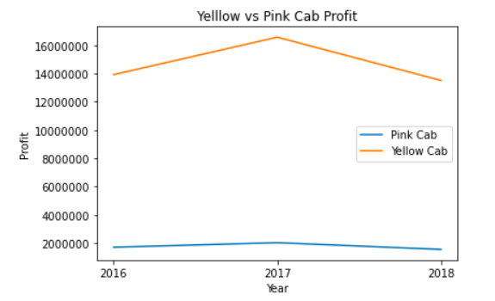
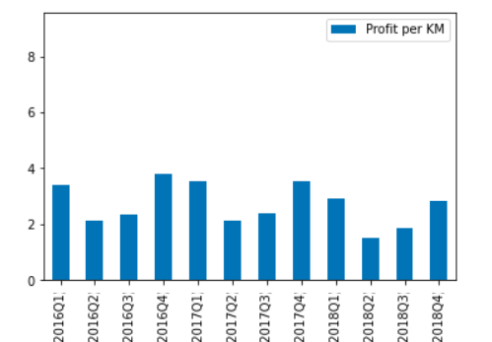
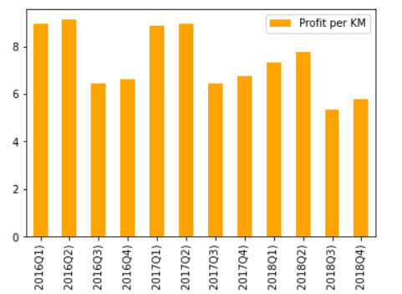
Data Analytics - Profit
Yellow Cab dominates Total Profit category, which is expected considering number of rides (previous slide)
Additionally, Yellow Cab performs much better in Profit per KM category, easily doubling the numbers

Slide 7
Data Analytics - Additional Analysis
Company | No. of Distinct Customers
Pink cab | 32330
Yellow cab | 39896
Pink - no. of rides per cust. (top 5) | Yellow - no. of rides per cust (top 5).
18 | 47
17 | 47
17 | 47
17 | 46
16 | 45
Yellow cab has slight advantage in terms of number of unique customers
Yellow cab’s customers use them much more frequently

Slide 8
Final Thoughts
Based on more-or-less all analysis done, Yellow Cab would be the better choice for investment!
Yellow cab performs better in almost all metrics available:
Number of rides over time
Profit
Profit per ride/KM
Number of distinct customers
Has a slightly better looking upwards trend
One thing that stands out when it comes to Pink cab - even though their data in terms of number of rides is significantly lower than Yellow, their number of unique/distinct customers is surprisingly high. This can mean different things, but one thing is for certain - they have a wide range of users.

Slide 9
Thank You!

